Slide 1
Panama PREP
Connection notes for Panama SVPs
SMU400 and Supermicro
09 March 2015

Slide 2
Panama PREP/ICS SVP Models
Purpose of this section
There are two different SVP models that may ship as part of PREP/ICS
  SMU400: shipped with early Panama PREP systems
  Supermicro (from Synnex): scheduled to begin shipment in early March with each PREP system
The network setup is different for each model and is described in the following slides

Slide 3




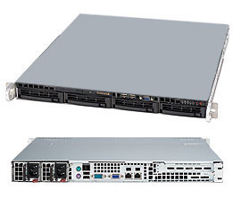
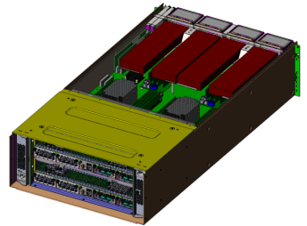

Network configuration – SMU400 SVP
PREP Environment
Network diagram
Hi-Track Center@San Diego
User's mgmt server
alert servers
(SNMP, syslog etc)
HCS
or
HID
Internet
User PC
NIC0 (192.168.0.200)
proxy
User's mgmt network
192.168.0.xxx/24
SVP=SMU400 (Win OS)
SVP Program and Hitrack
mgmt: 192.168.0.16
.17
CTL1
CTL2
mainte: 10.0.0.16
.17
On-board NIC
192.168.0.15/24
10.0.0.100/24
LAN1
2
switch
MPC Program
10.0.0.15/24
MPC (for CE)

Slide 4
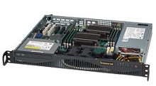
Network configuration – Supermicro SVP
PREP Environment
Network diagram
Hi-Track Center@San Diego
User's mgmt server
alert servers
(SNMP, syslog etc)
HCS
or
HID
Internet
User PC
NIC0 (192.168.0.200)
proxy
User's mgmt network
192.168.0.xxx/24
SVP=Supermicro(Win OS)
HM800 DKC is connected to user's mgmt LAN through a network bridge on SVP (see later slide).
SVP Program and Hi-track
LAN2 is for SVP maintenance for CE and user (for Initial Startup Tool (IST)).
On-board NIC
Bridge
(192.168.0.15)
10.0.0.100/24
MPC Program
# of necessary IPs for user's mgmt LAN is 3 (bridge + CTL1& CTL2). # of necessary physical port is 1.
LAN1
3
4
2
or
10.0.0.15/24
mgmt: 192.168.0.16
.17
MPC (for CE)
CTL1
CTL2
mainte: 10.0.0.16
.17
HM800 DKC

Slide 5
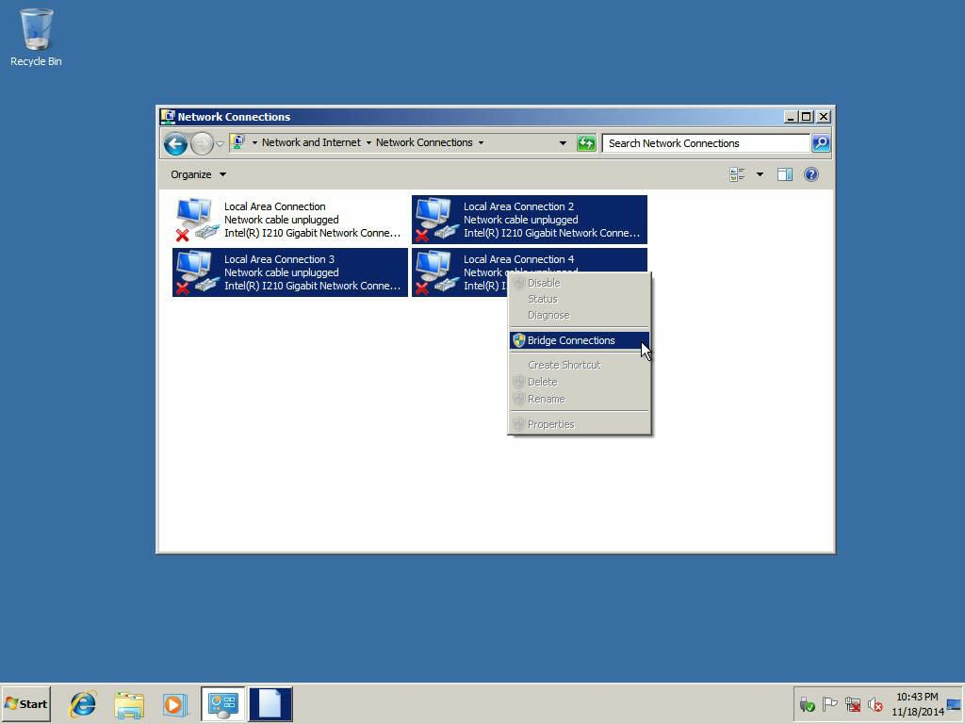
Network configuration - Bridge setting on SuperMicro SVP
PREP Environment
Network bridge
A network bridge on SVP acts as a switching hub. This bridge consisting of on-board NICs can be configured by "Bridge Connections" setting in existing functions of Windows OS (No external switching hub is necessary).
Setup procedure of network bridge
1) Select three NICs at the same time, right click, and select “Bridge Connections”.
2) A new instance of network bridge appears.
3) Set a new IP address to the network bridge (192.168.0.15).
User's mgmt server
User's mgmt network
NIC0 (192.168.0.200)
192.168.0.xxx
SVP=Supermicro (Win OS)
On-board NIC
Bridge
(192.168.0.15)
10.0.0.100
LAN1
3
4
LAN2 for SVP maintenance
mgmt: 192.168.0.16
.17
CTL1
CTL2
HM800 DKC

Slide 6
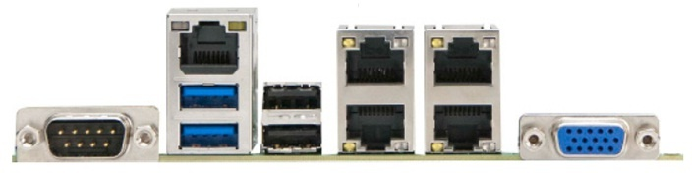
Network configuration - Physical LAN port assignment
PREP Environment
Rear I/O panel layout of Supermicro SVP
The figure below shows the physical LAN port assignment.
TO: HM800 DKC CTL1
TO: HM800 DKC CTL2
IPMI port
(not supported)
LAN3
LAN4
LAN1/3/4 consists of a bridge
LAN1
LAN2
TO: MPC for SVP maintenance and user PC for IST
TO: User's mgmt network

